Slide 1
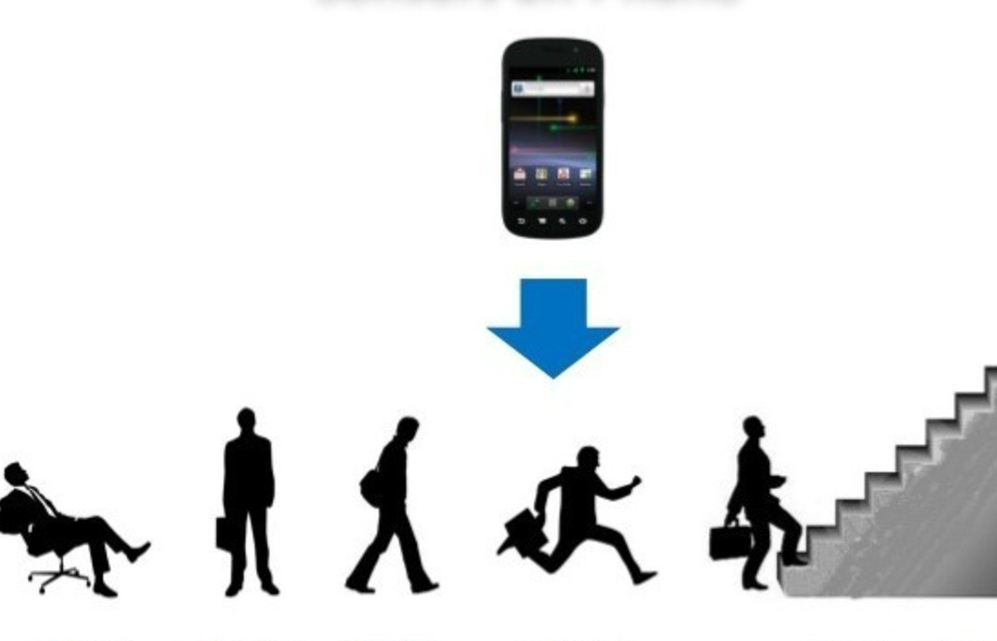
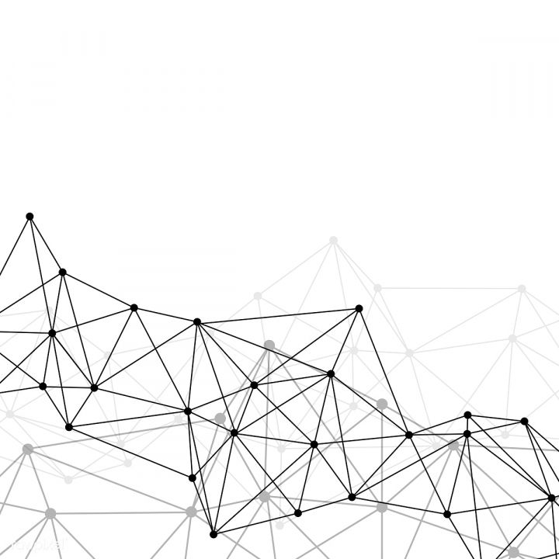
Human Activity Recognition with Smartphones
Name: Shayan Tafrishi
StudentID: 906851

Slide 2
Content
Introduction
Data analysis
Pre-processing
Neural Network Architecture
Training and optimization
Tensorboard and Best Model Selection
Model Performance
Streamlit Dashboard
Conclusion

Slide 3
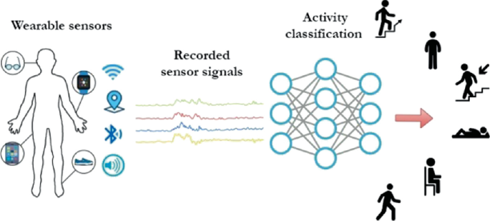
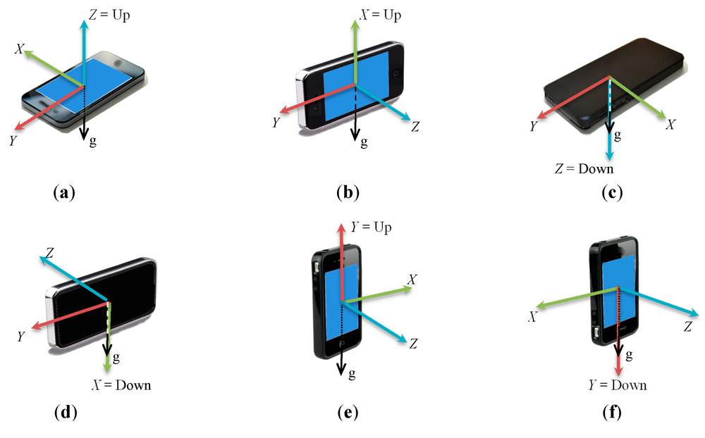
Introduction
Dataset: UCI ML Human Activity Recognition with Smartphones dataset with Smartphones dataset available on Kaggle.
30 study participants
Smartphone with embedded inertial sensors
Goal: Develop a model for accurate activity classification

Slide 4
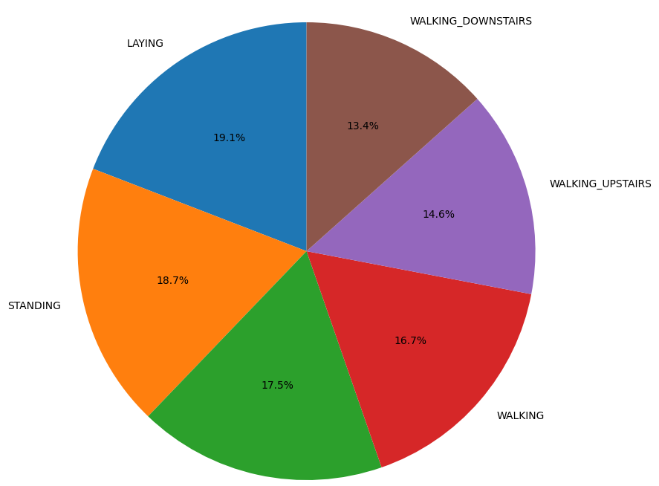
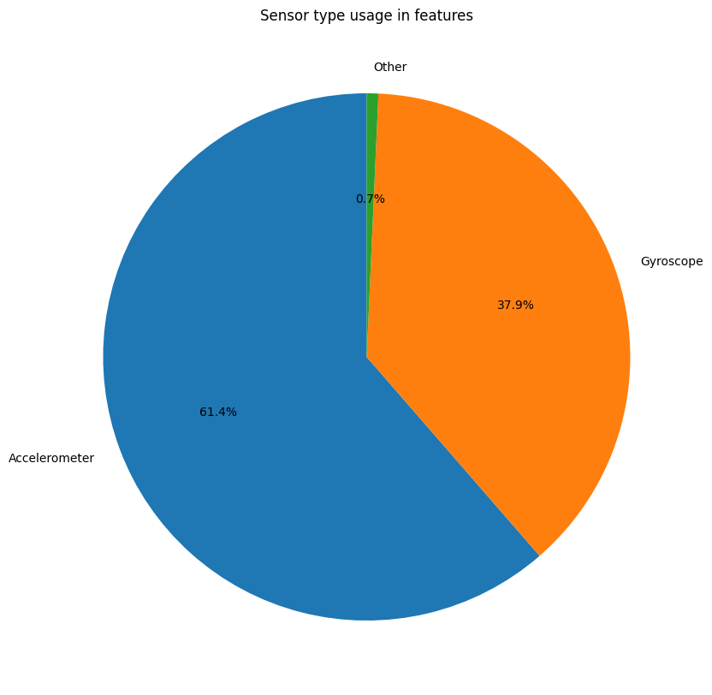
Data analysis
No missing values in the dataset
Well-balanced target class distribution
561 sensor features derived from accelerometer, gyroscope, and other variables
Majority of features are accelerometer-based

Slide 5
Pre-processing
Label encoding of activity labels
Feature normalization using StandardScaler
Conversion to PyTorch tensors
Custom Dataset class and DataLoader for efficient loading

Slide 6
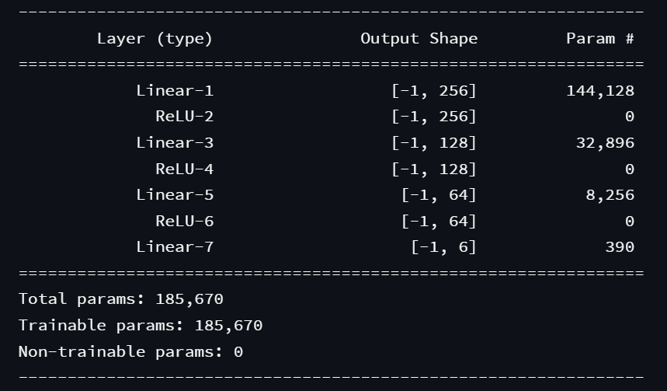
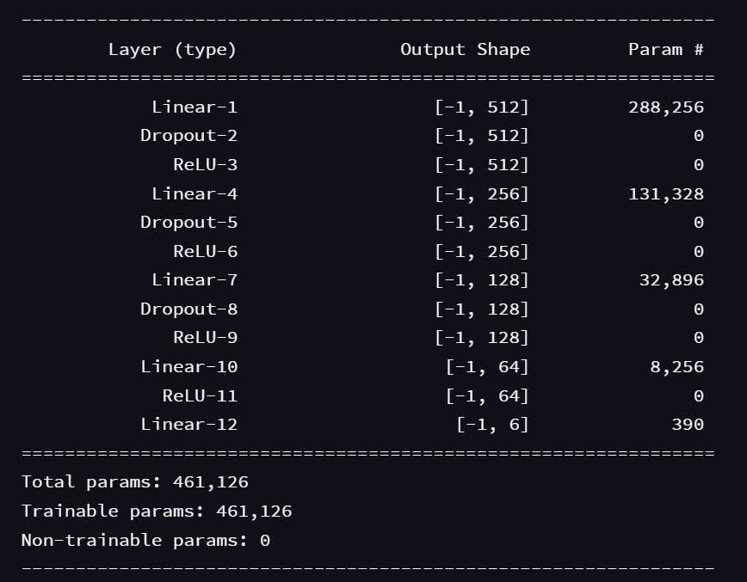
Neural Network Architecture
NeuralNet 1
NeuralNet 2
4 hidden layers: 512, 256, 128, and 64 dimensions
Dropout layers (0.2) for regularization
ReLU activation function
3 hidden layers: 256, 128, and 64 dimensions
ReLU activation function.

Slide 7
Training and optimization
Adam optimizer with learning rate of 0.001 for NeuralNet
Adam optimizer with learning rate of 0.01 for NeuralNet2
CrossEntropyLoss as the loss function for multi-class classification

Slide 8
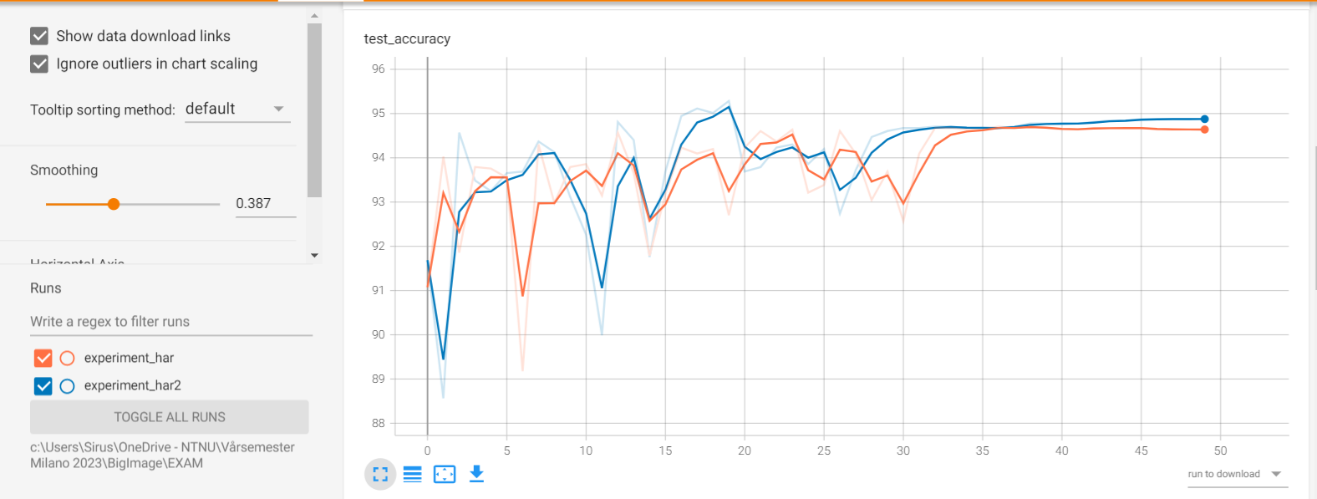
Tensorboard
A powerful visualization tool
Visualize training and validation losses
Monitor training and validation accuracies
Aid in identifying overfitting or underfitting
Select best model based on test accuracy

Slide 9

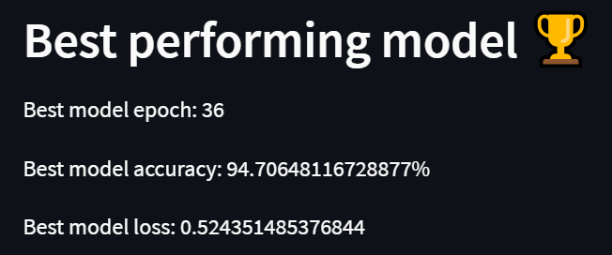
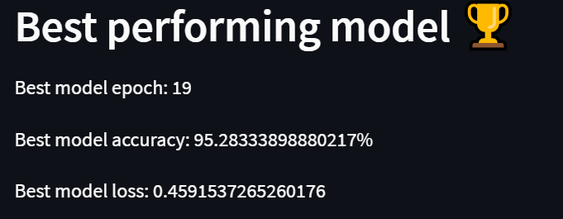
Best Model Selection
NeuralNet 1

Slide 10
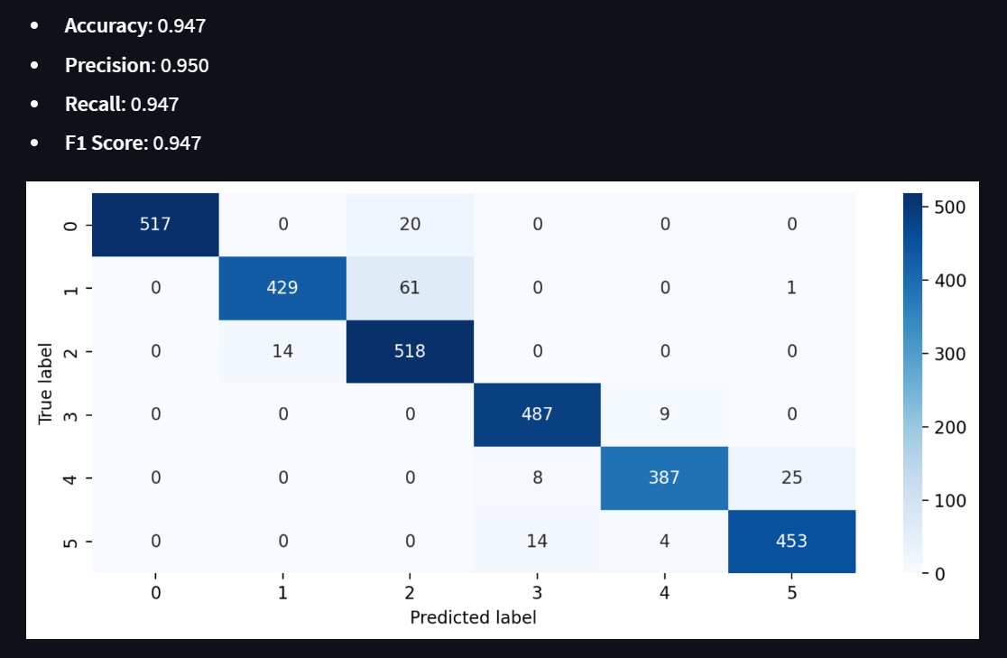
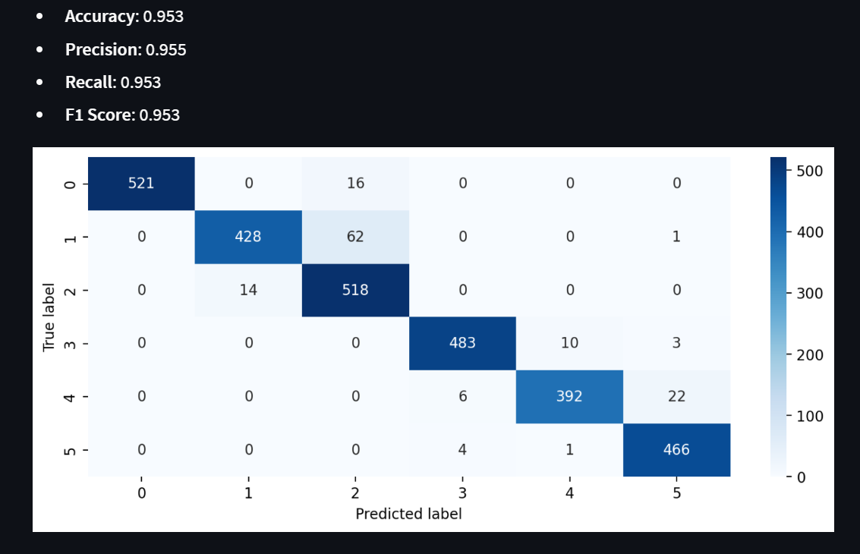
Model Performance
NeuralNet 1

Slide 11

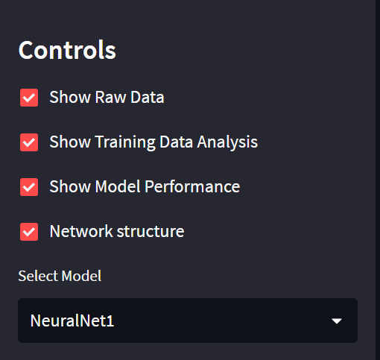
Streamlit Dashboard
Controls for data, analysis, performance, and structure
Model selection and performance metrics display
Visualization of network structure using torchsummary

Slide 12


Conclusion
High accuracy and performance in activity recognition
NeuralNet2 outperforms NeuralNet1
Effective use of Tensorboard and confusion matrices
Effectiveness of neural networks

